Slide 1


gpex.com.au/nbcsp-education

Slide 2

gpex.com.au/nbcsp-education

Slide 3

gpex.com.au/nbcsp-education

Slide 4
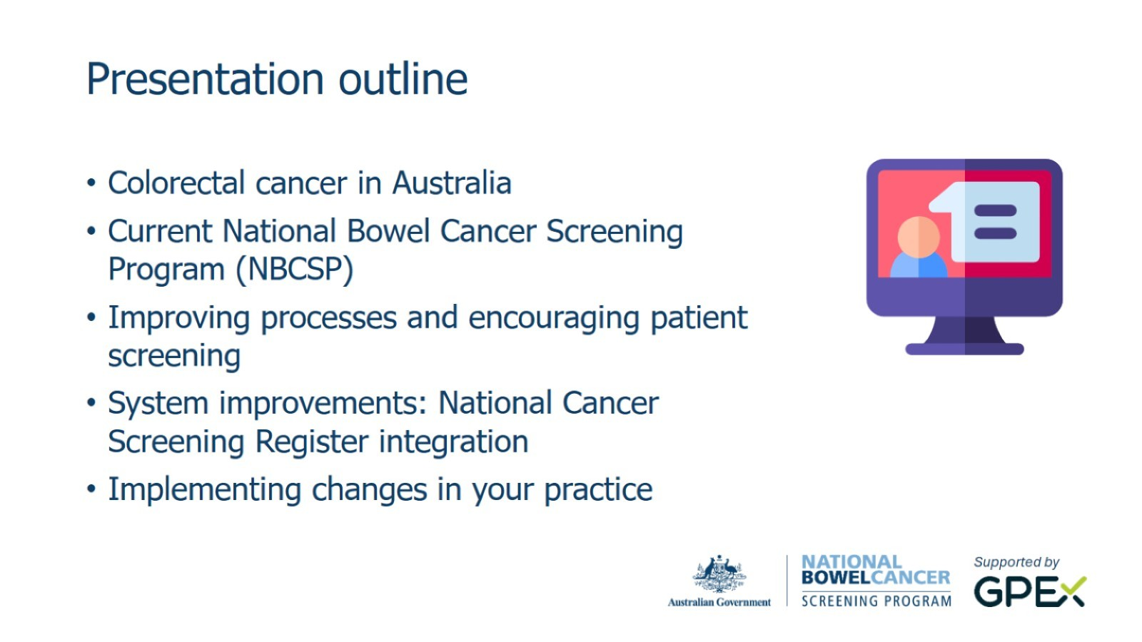
gpex.com.au/nbcsp-education

Slide 5
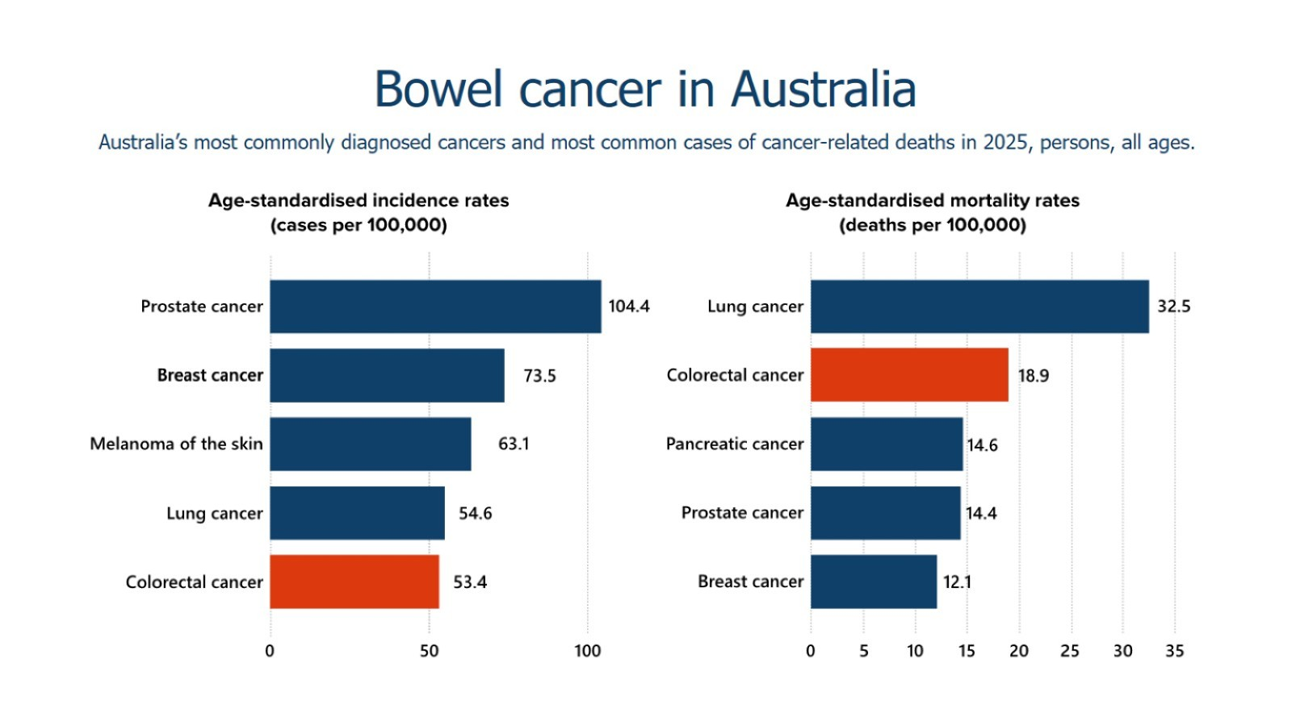

Slide 6
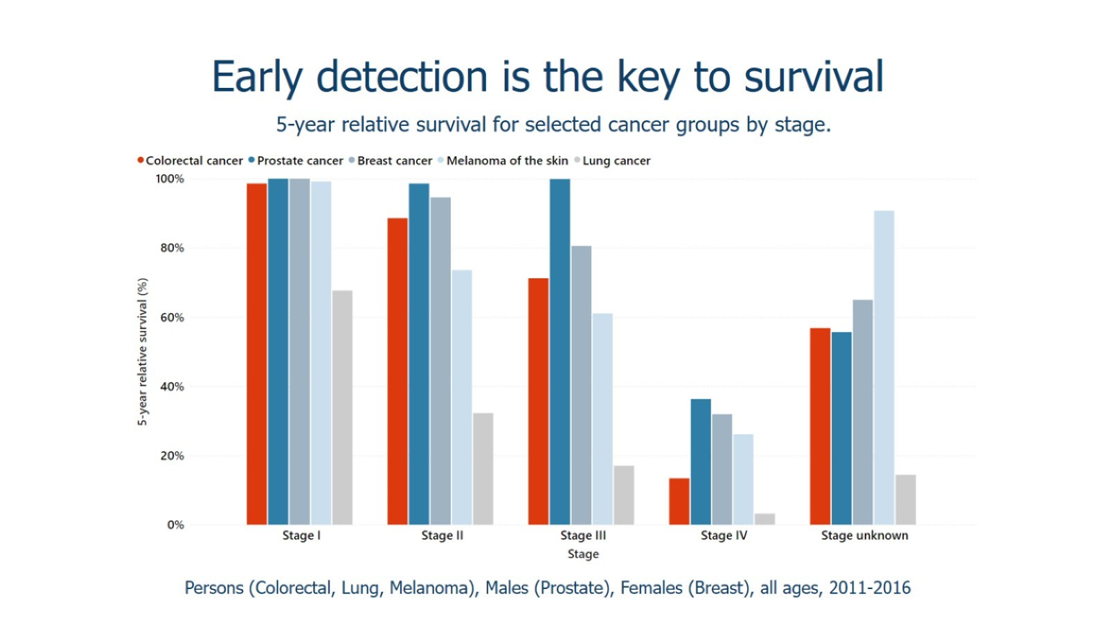

Slide 7
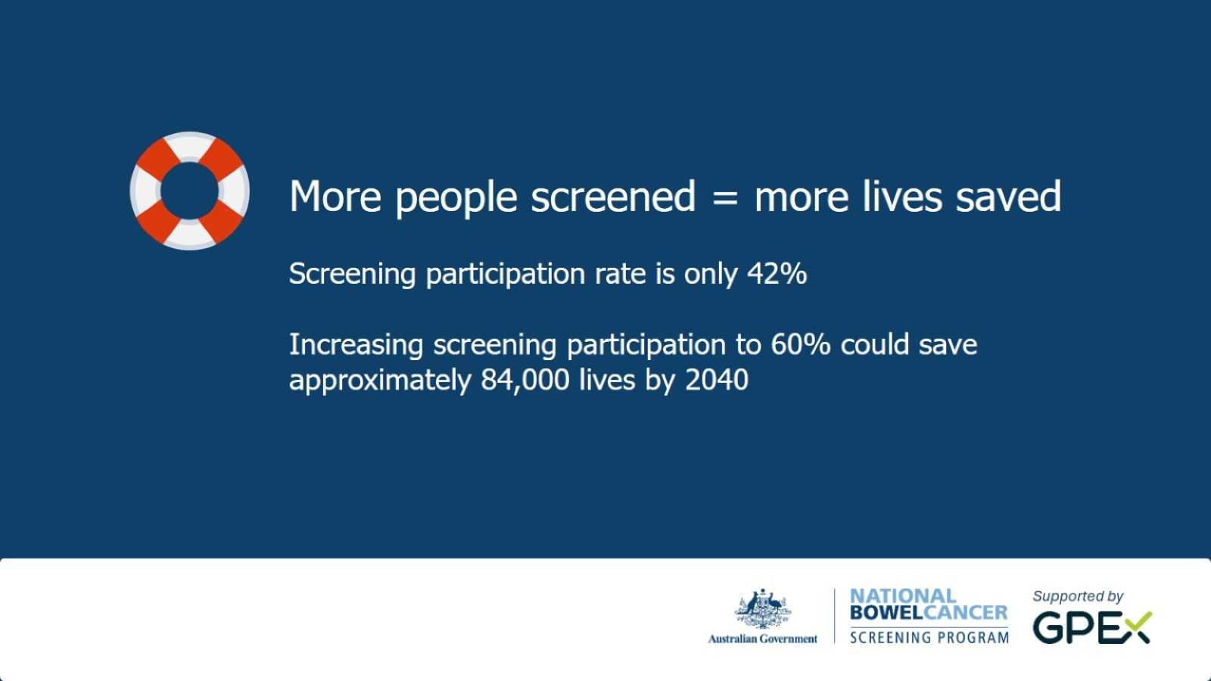
gpex.com.au/nbcsp-education

Slide 8
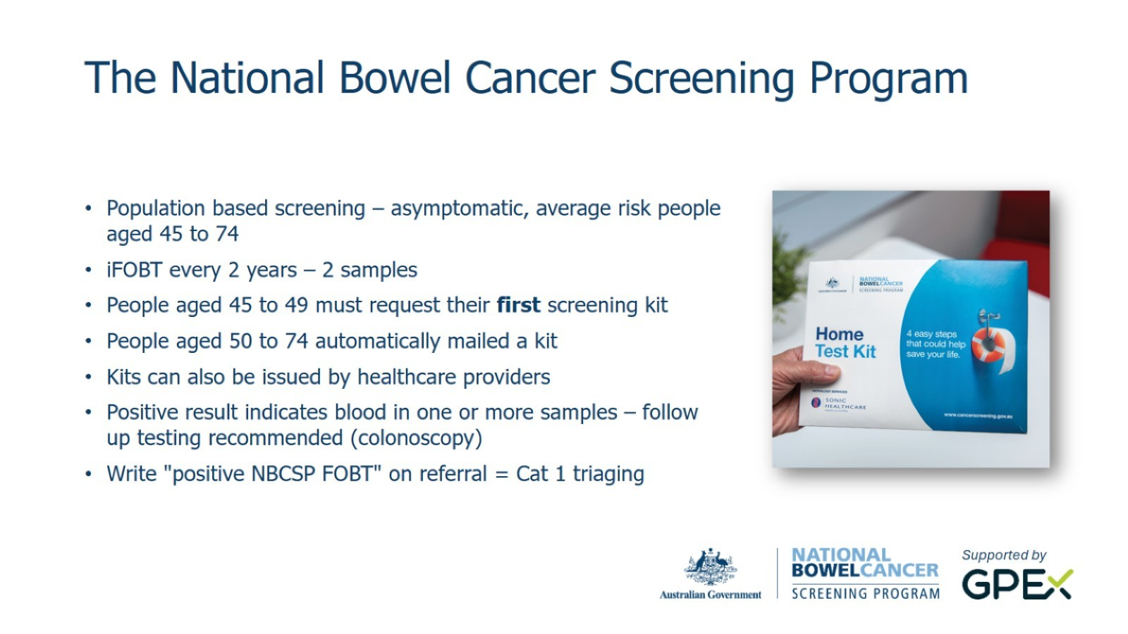
gpex.com.au/nbcsp-education

Slide 9


Slide 10
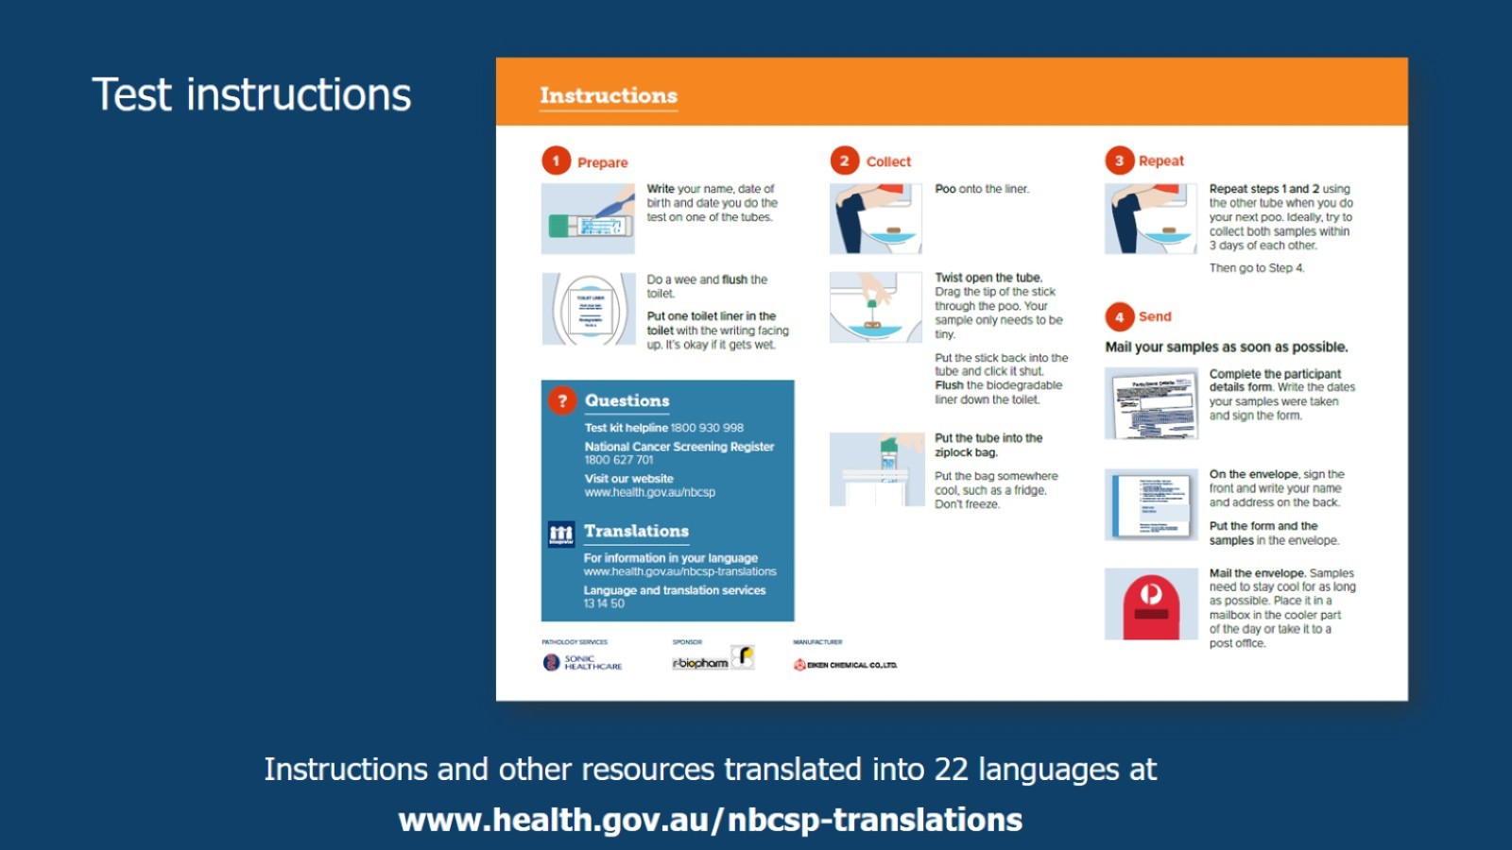

Slide 11
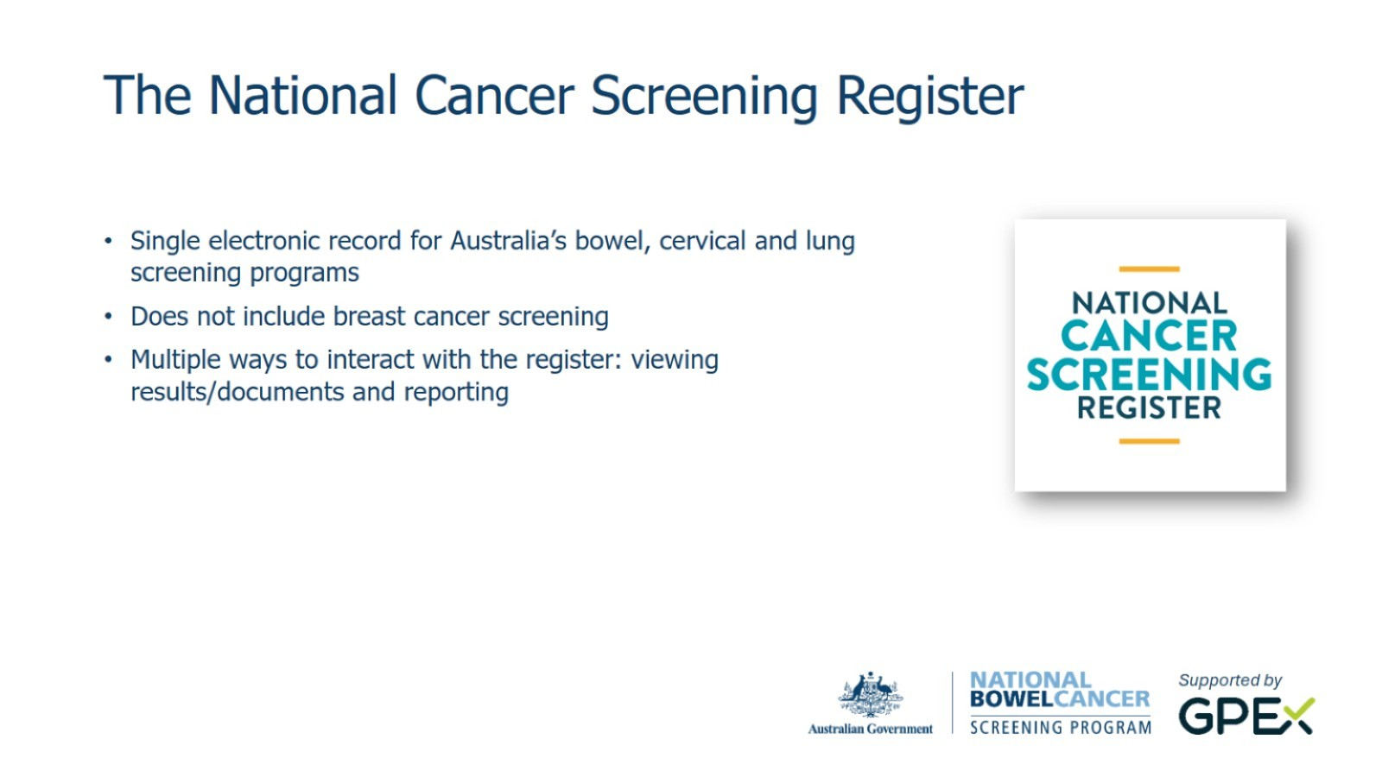
gpex.com.au/nbcsp-education

Slide 12
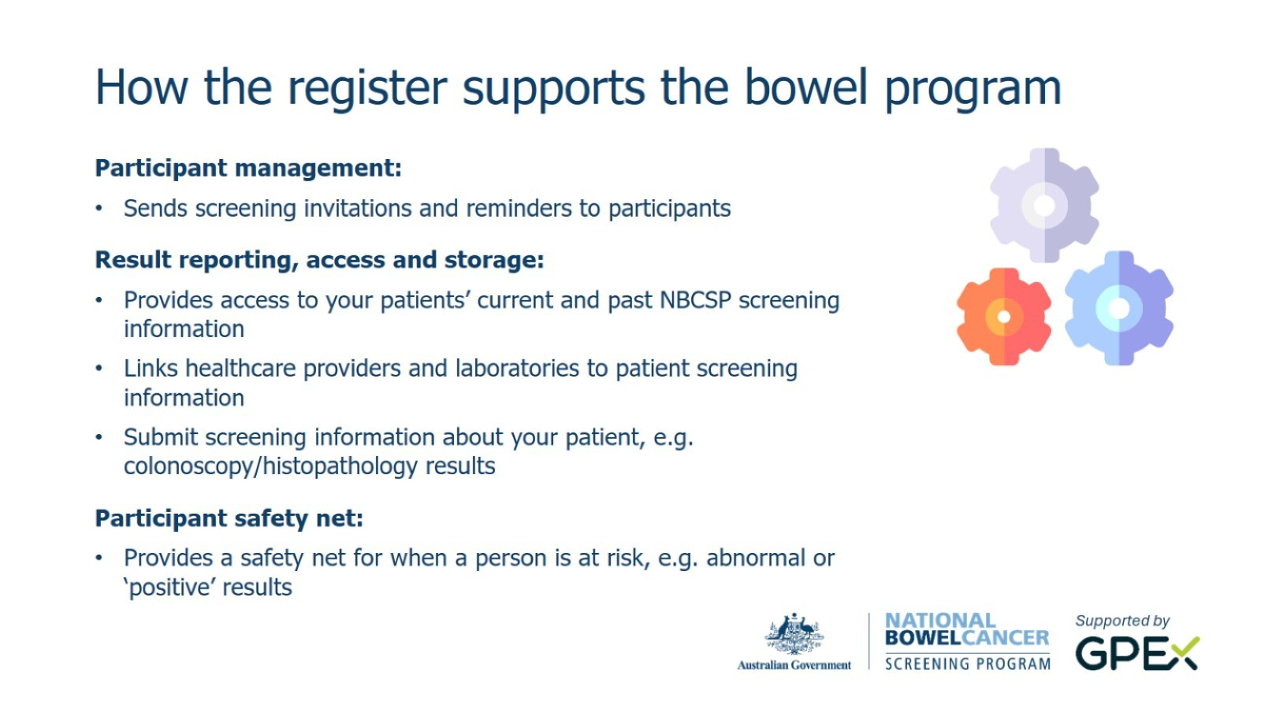
gpex.com.au/nbcsp-education

Slide 13
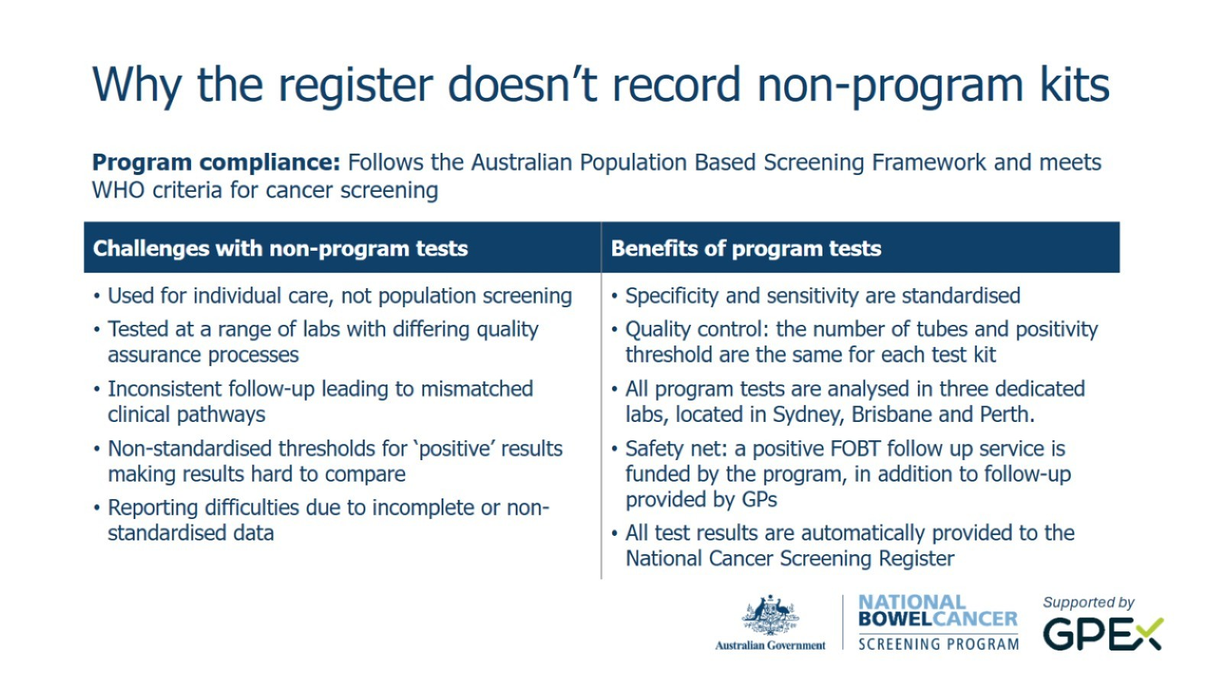
gpex.com.au/nbcsp-education

Slide 14
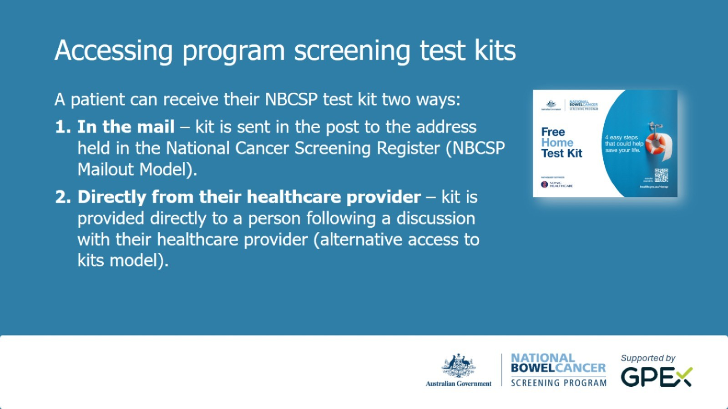
gpex.com.au/nbcsp-education

Slide 15
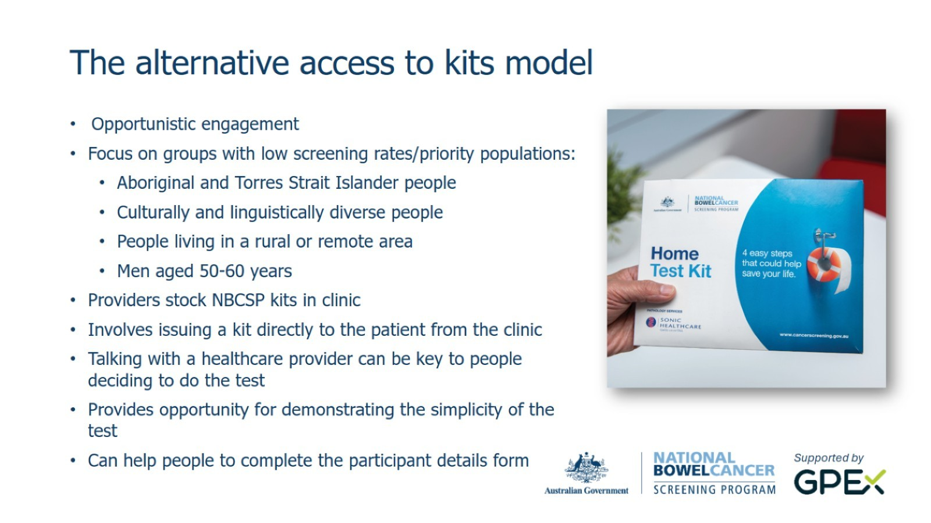
gpex.com.au/nbcsp-education

Slide 16
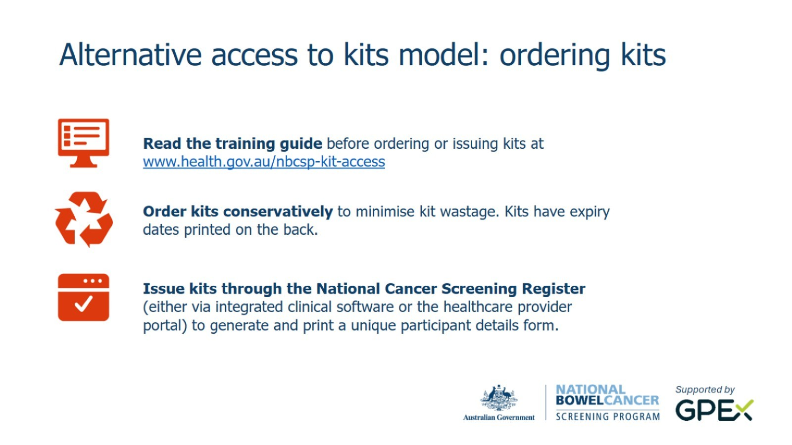
gpex.com.au/nbcsp-education

Slide 17
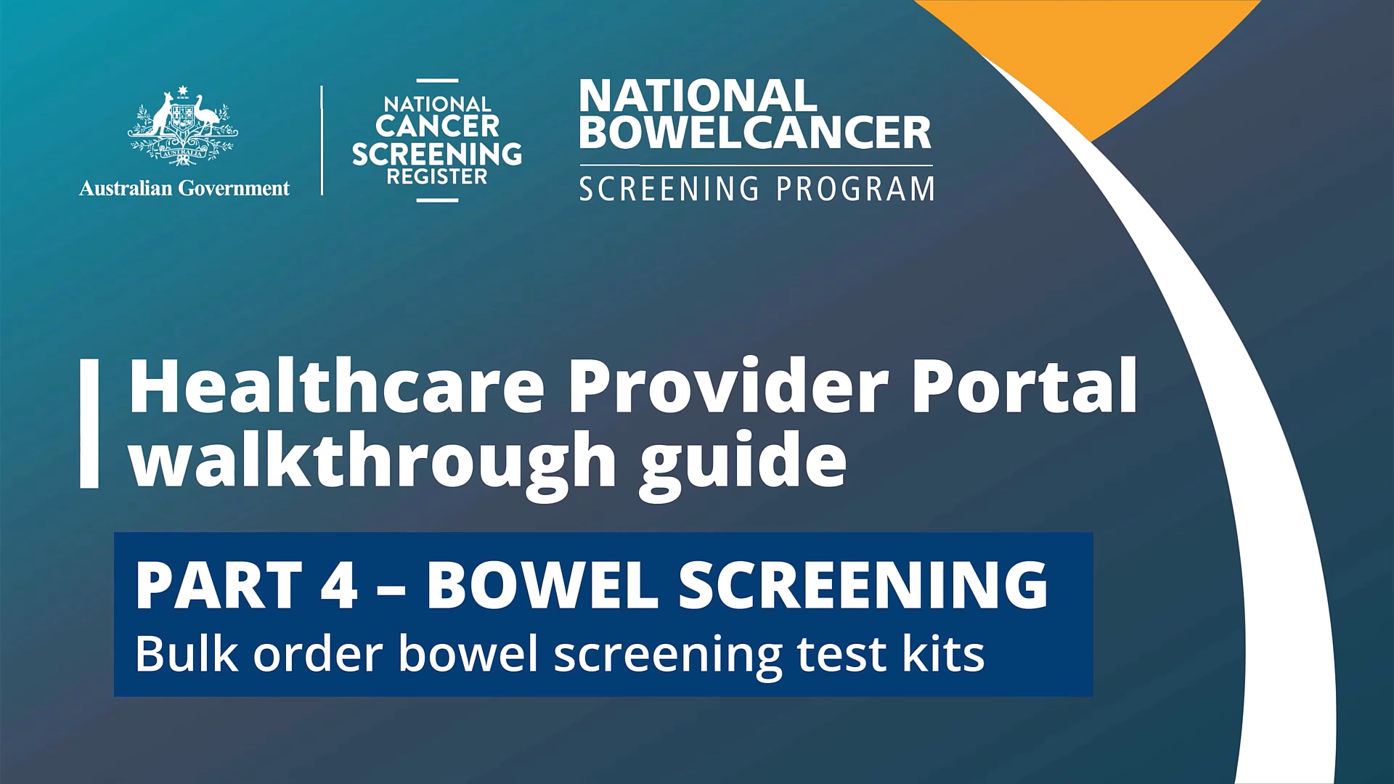

Slide 18
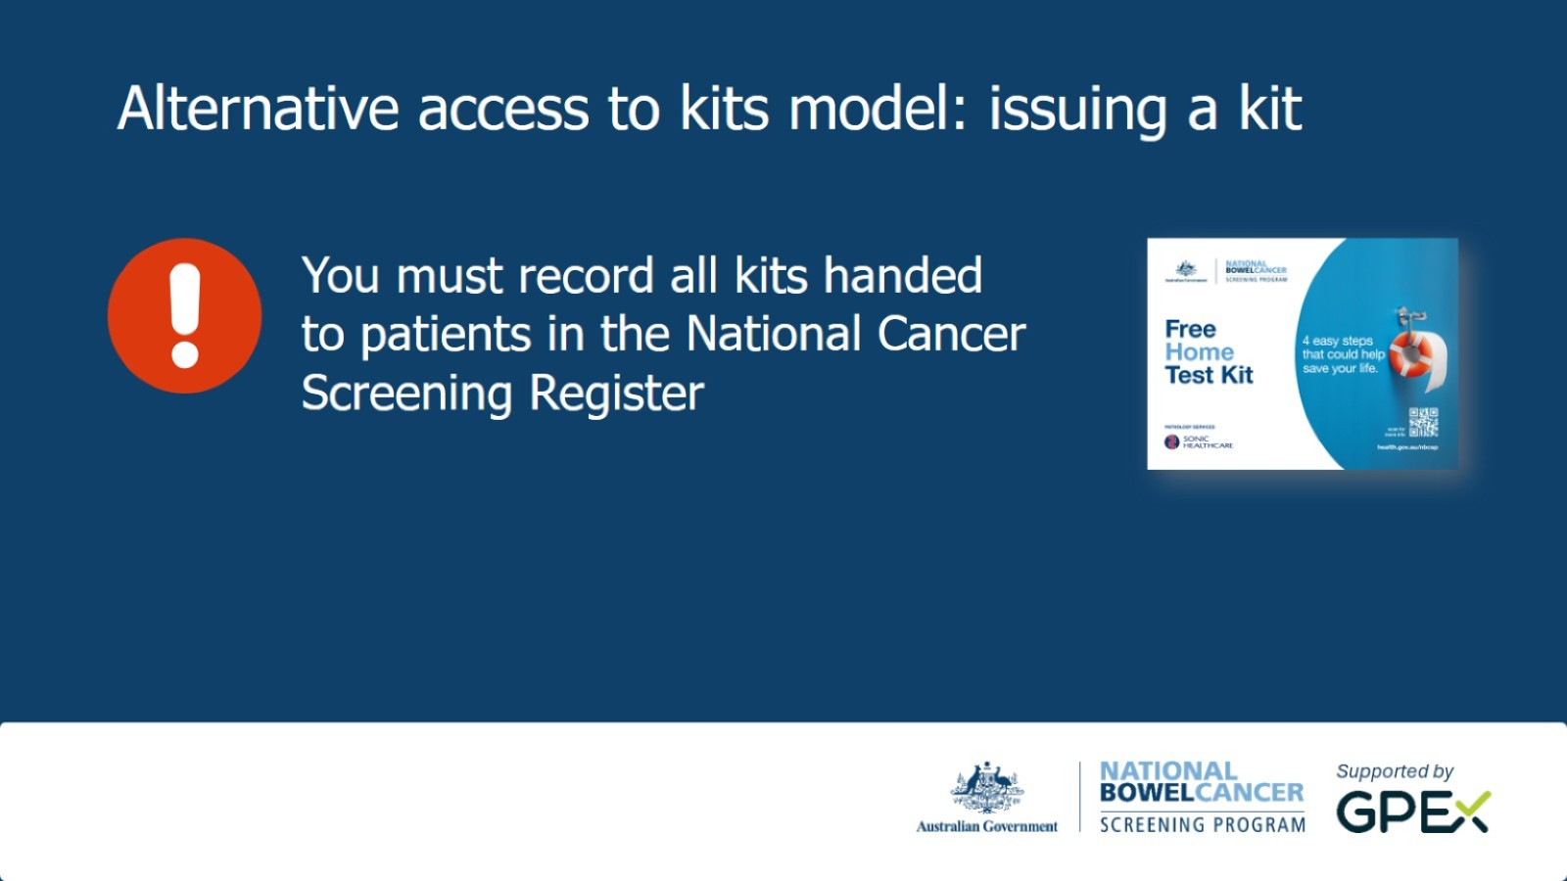
gpex.com.au/nbcsp-education

Slide 19
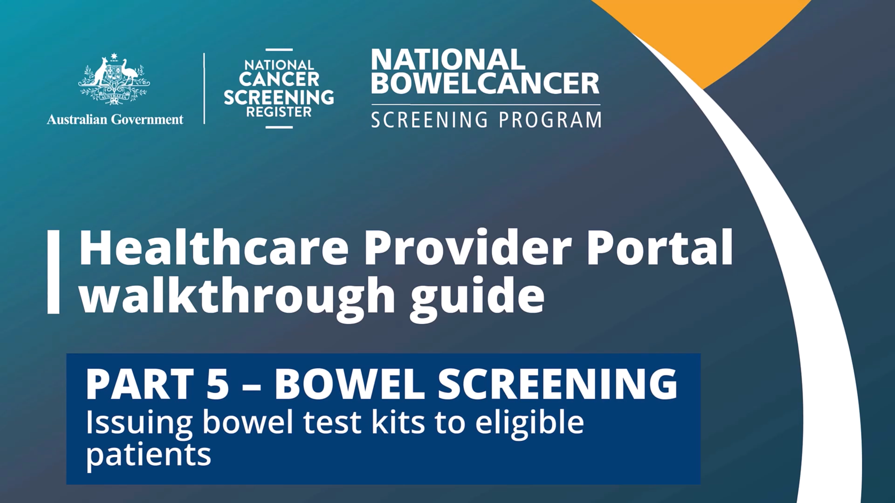

Slide 20
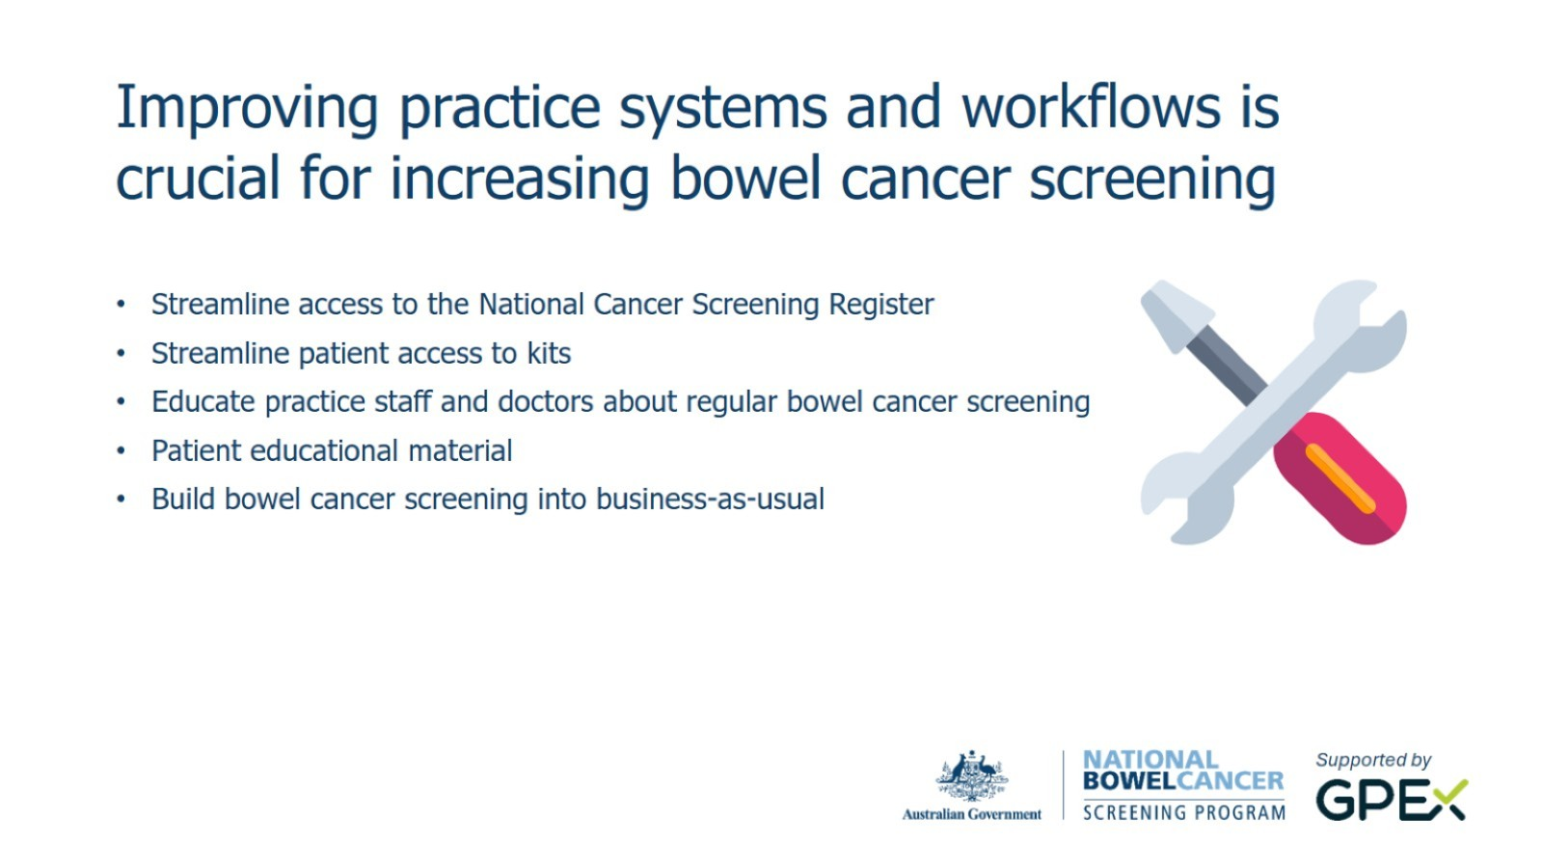
gpex.com.au/nbcsp-education

Slide 21
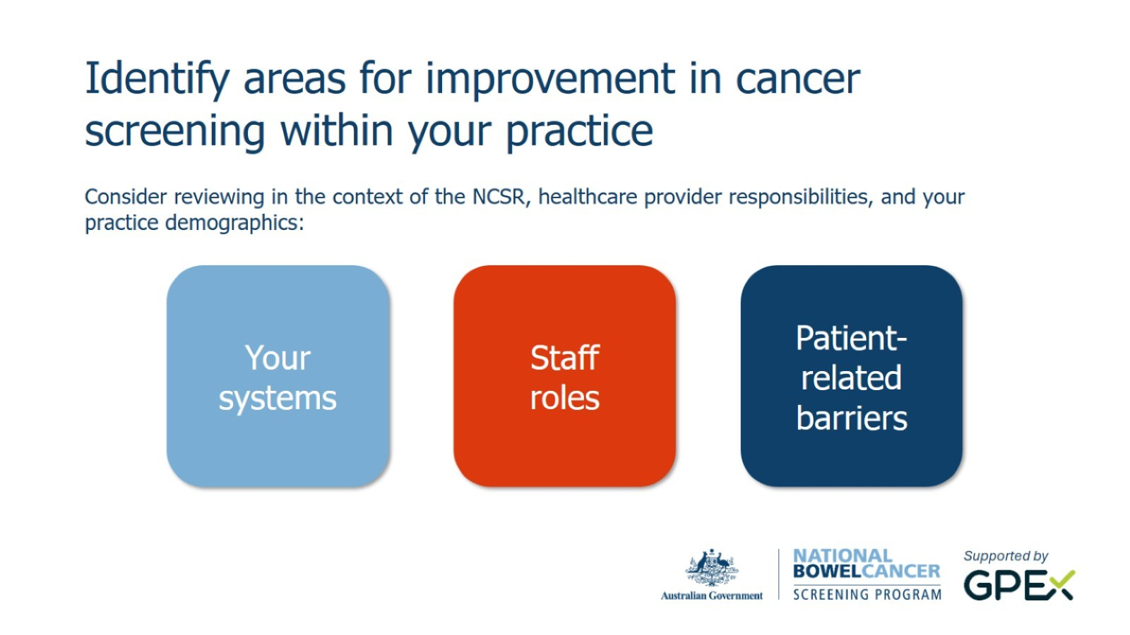
gpex.com.au/nbcsp-education

Slide 22
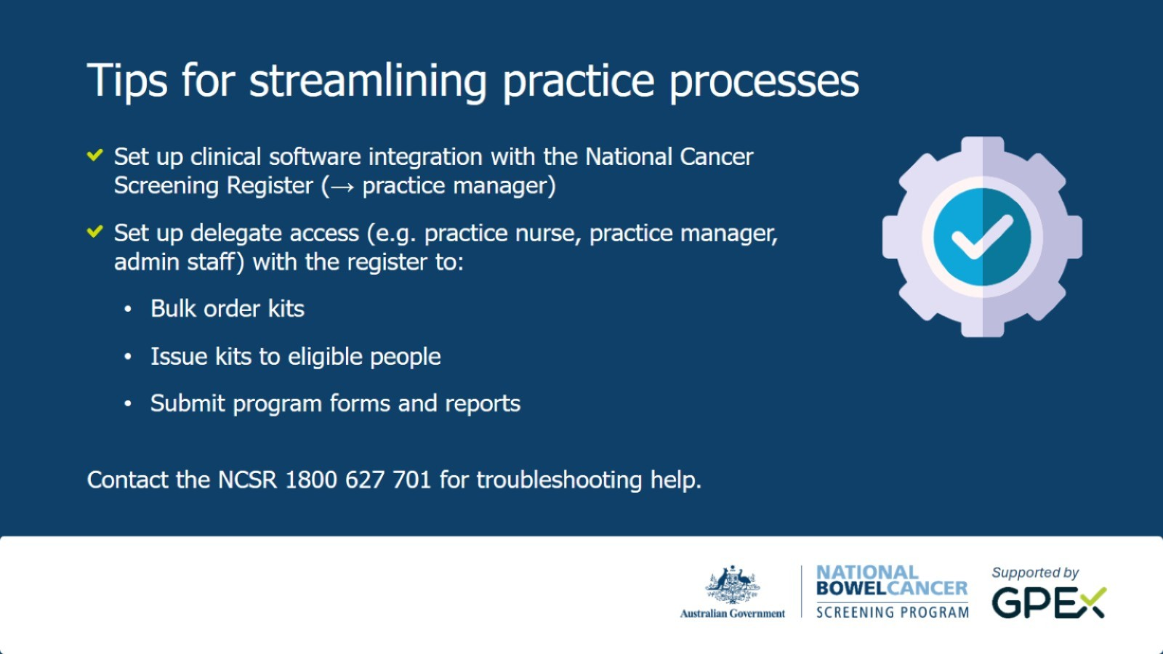
gpex.com.au/nbcsp-education

Slide 23
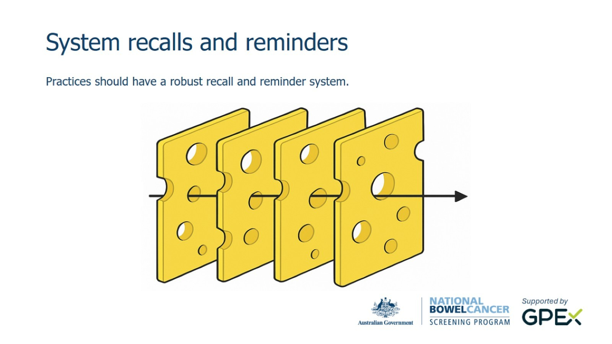
gpex.com.au/nbcsp-education

Slide 24
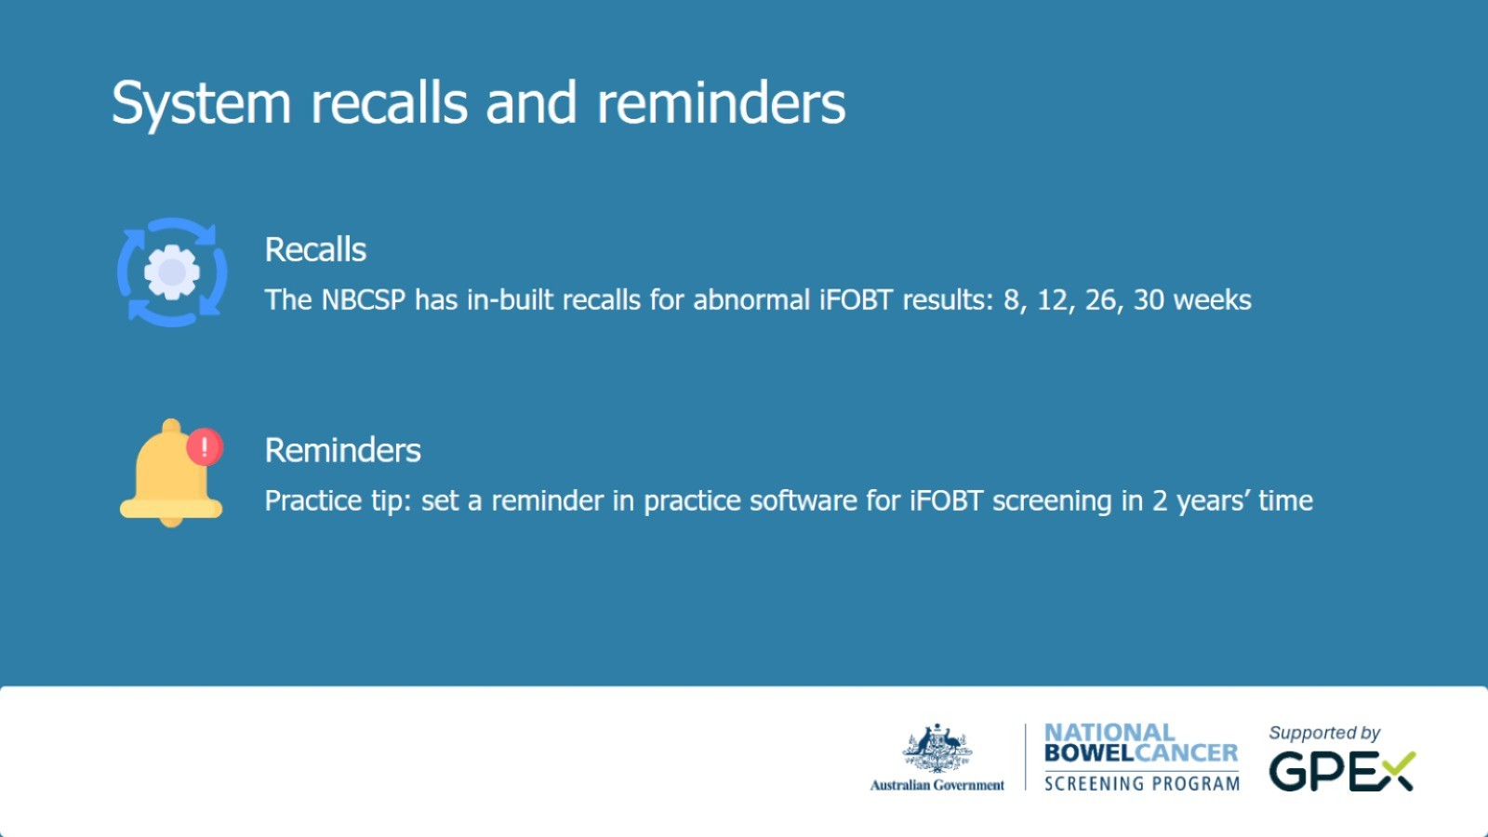
gpex.com.au/nbcsp-education

Slide 25

gpex.com.au/nbcsp-education

Slide 26
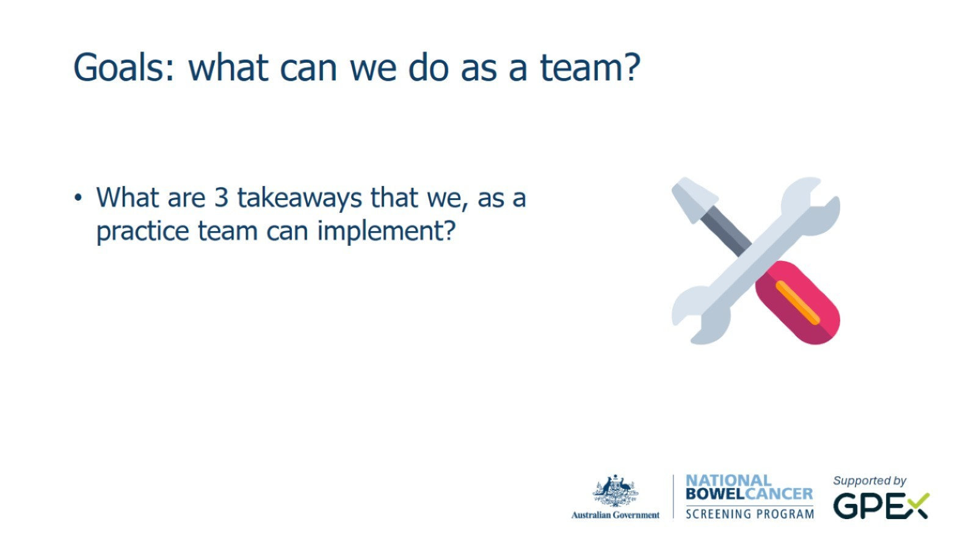
gpex.com.au/nbcsp-education

Slide 27

gpex.com.au/nbcsp-education

Slide 28

gpex.com.au/nbcsp-education

Slide 29

gpex.com.au/nbcsp-education

Slide 30


