Slide 1
Trusted Quality Education
For Primary Care

Slide 2

Lifting the lid on participation: conducting effective audits to improve National Bowel Cancer Screening Program uptake
Notes:
Holding screen

Slide 3
Acknowledgement of Country
GPEx and the Department of Health, Disability and Ageing acknowledges the Traditional Owners and Custodians of Country on which we are meeting today, and their continuing connection to land, sea and community. We pay our respects to them and their cultures, and to Elders both past and present.
Notes:
GPEx FACILITATOR

Slide 4
Welcome
Notes:
GPEx FACILITATOR

Slide 5

Pre-knowledge check
Notes:
GPEx FACILITATOR

Slide 6

Presenter introduction
Dr. Alireza Ahmadvand, MD, PhD, FRACGP, is a leading General Practitioner, Associate Professor, and medical researcher specialising in primary care, epidemiology, and digital health.
Currently, Associate Professor at Griffith University’s School of Medicine and Dentistry, focusing on medical education and research. Clinically, Alireza works as a Senior Medical Officer and GP with Special Interest in Gastroenterology at Princess Alexandra Hospital in Brisbane, and as a GP at Our GP Complex Spring Hill.
Notes:
GPEx FACILITATOR
[Note: Slide will be updated to reflect speaker(s) at individual events.]

Slide 7
Overview of workshop
Overview of the National Bowel Cancer Screening Program (NBCSP)
National Cancer Screening Register
Summary of the Alternative Access to Kits Model
Under screened populations
  Case studies – small group discussion
Guided mini audit activity
Notes:
SPEAKER
This workshop is part of our National Bowel Cancer Screening Program healthcare provider training package.
In this workshop, we will be going through a brief overview of the National Bowel Cancer Screening Program, the National Cancer Screening Register and the Alternative Access to kits model as these are important aspects of the program which can lead to increased Program uptake. Many of you attending tonight will be familiar with aspects of the National Bowel Cancer Screening Program but this education is aimed at ensuring that the practices being implemented are in line with the Program Guidelines and to give you suggestions for how you might streamline these processes within your practice and workflows.
This workshop is intended to be interactive and throughout it, we will be focussing on bowel cancer screening in people who are under screened, or who have never screened. We will be using case discussions to explore the barriers to screening and some of the enablers that you, as a practitioner or a member of the practice team, can implement to encourage screening within your practice.
This workshop is intended to be practical to get you started on practice improvements around bowel cancer screening in addition to enabling you to commence an audit to improve bowel cancer screening processes and uptake within your clinic.
Getting started with planning for an audit is often the most challenging step, so we are hoping to break this down for you and provide you with the tools for audit success. We have provided you with mini audit templates in the email prior to today's workshop which we will explore in more detail and will hand out additional copies later in the workshop.

Slide 8
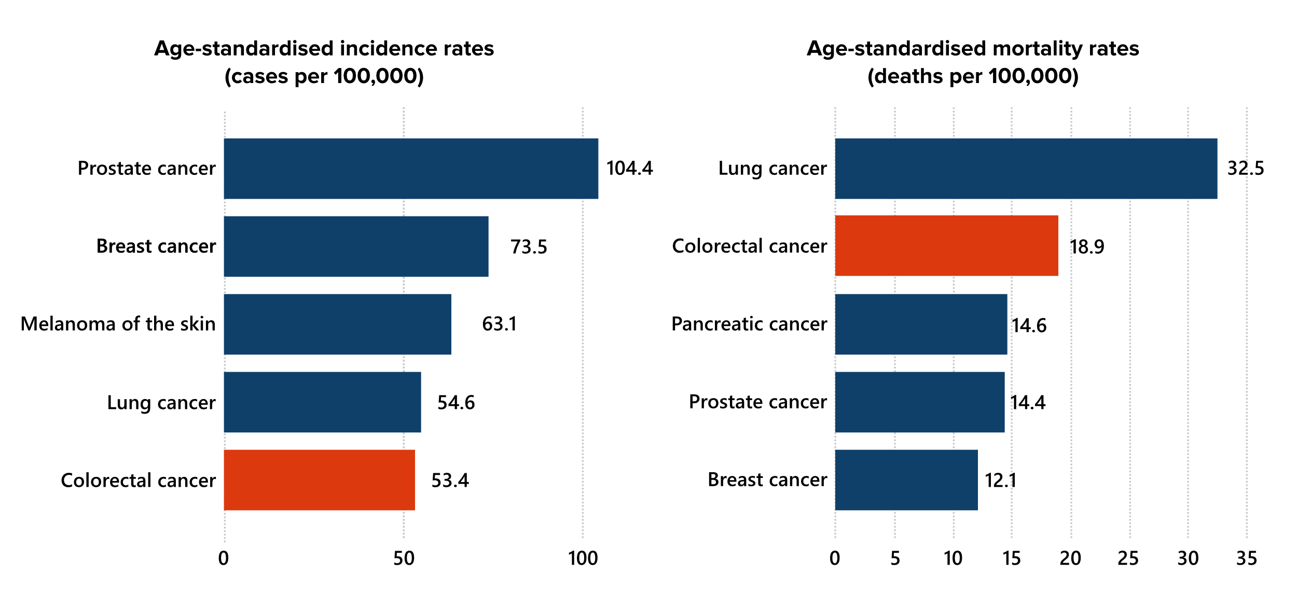
Colorectal cancer in Australia
Australia’s most commonly diagnosed cancers and most common cases of cancer-related deaths in 2025, persons, all ages.
Notes:
SPEAKER
We are going to begin with an overview of colorectal cancer in Australia.
In 2025, colorectal cancer was projected to be the fifth most commonly diagnosed cancer in Australians of all ages after prostate cancer, breast cancer, melanoma of the skin and lung cancer.
It was also estimated that in 2025, colorectal cancer would remain the second most common cause of death from cancer in Australia after lung cancer.
Although bowel cancer mortality rates are decreasing, due to our aging population, there are more people are dying from the disease.
More statistics are available from:
Getting to the bottom of bowel cancer in Australia: breaking down the data and what you need to know to put it into practice

Slide 9
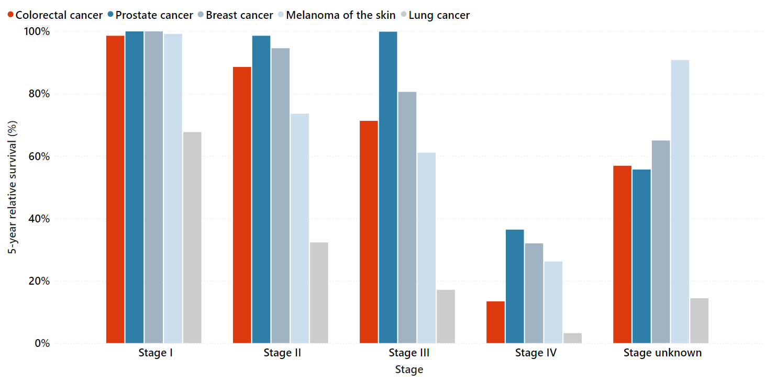
Early detection is key to survival
5-year relative survival for selected cancer groups by stage.
Persons (Colorectal, Lung, Melanoma), Males (Prostate),
Females (Breast), all ages, 2011-2016
Notes:
SPEAKER
When colorectal cancer is detected early, there is greater opportunity for curative treatment -this is demonstrated by this graph which shows the 5-year relative survival of five types of cancer.
Colorectal cancer is represented by the red columns:
- The five-year relative-survival rate for colorectal cancer diagnosed at Stage I was 99%.
- Survival rates for colorectal cancer diagnosed at Stage IV were 13%.
This is compared to prostate cancer (dark blue), breast cancer (dusky blue), melanoma (light blue) and lung cancer (grey).

Slide 10
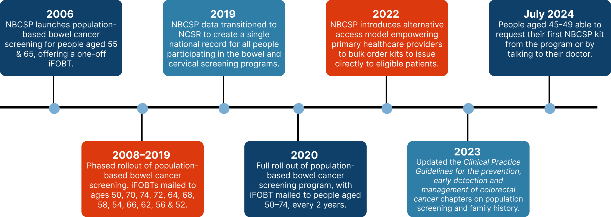
Changes to the NBCSP since inception
Notes:
SPEAKER
This slide summarises the changes that have occurred to the National Bowel Cancer Screening Program since its inception in 2006. If you have been practicing for the last 20 years, you are likely to have seen all of these changes in your professional career.
To begin with, the program only sent out iFOBT kits to people aged 55 and 65. Over the years, the age eligibility range of the program and screening interval has changed. From 2020, everyone aged 50-74 was invited to screen every 2 years.
The Program’s alternative access to kits model began in 2022. We will talk about what this means later in the workshop.
The updated Clinical Practice Guidelines were released in 2023 and from 1 July 2024, the eligible age to commence screening with the NBCSP was lowered to 45. However for people aged 45-49, this is an OPT-IN program only, where individuals can contact the NCSR directly to receive their first kit or the healthcare provider can opt the patient in.

Slide 11
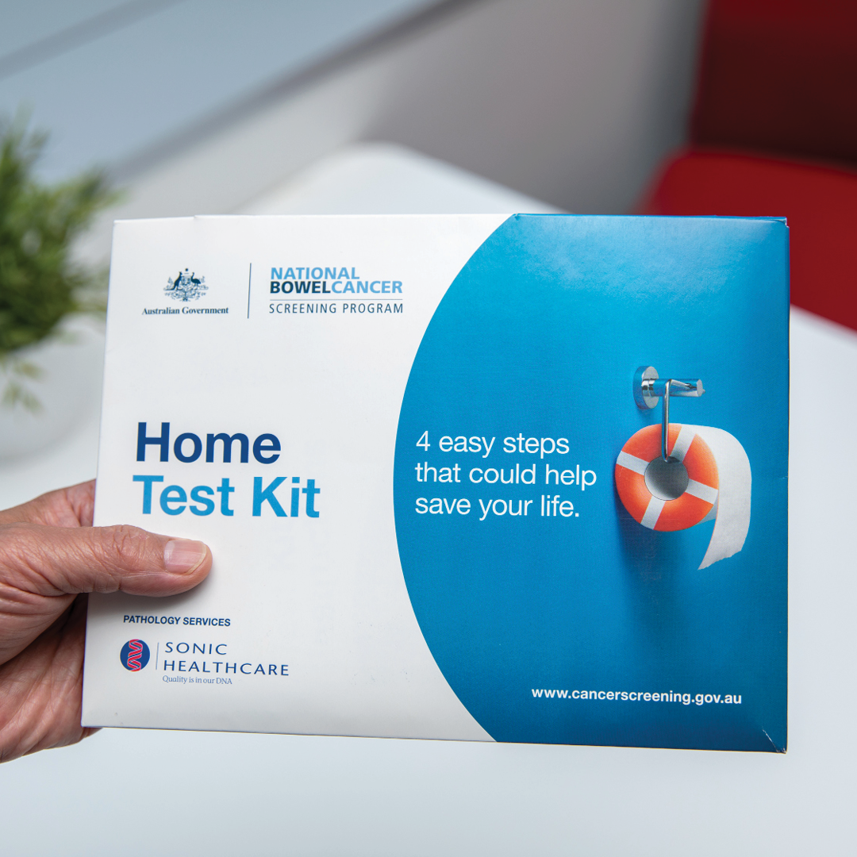
Current NBCSP
Population based screening – asymptomatic low-risk patients
iFOBTs every 2 years from 45-74 years of age – 2 iFOBT samples per kit
Kits are received via mail or handed out via healthcare providers (alternative access model)
Positive results indicate blood in one or more samples – follow up testing recommended (colonoscopy)
Write "positive NBCSP FOBT" on referral – Cat 1 triaging
Notes:
SPEAKER
To summarise, in line with current clinical guidance, the current age range for screening with the NBCSP is 45–74 years. The program uses an immunochemical faecal occult blood test with 2 samples within the kit and provides a screening kit to eligible people every 2 years.
Participants receive their kit either via mail, or via their healthcare provider through the alternative access to kits model (AAM).
AAM supports providers to bulk order and issue NBCSP kits directly to a patient.
A positive result indicates that blood has been seen in one or both of the iFOBT samples and it is recommended that you discuss this result with the patient and assess their life expectancy and goals of care. Clinical guidance for a positive iFOBT is a colonoscopy. The referring practitioner should discuss colonoscopy with their patient and use their clinical judgement to refer on a case-by-case basis.
If you are referring a patient for a colonoscopy due to a positive NBCSP FOBT, then write "positive NBCSP FOBT" on the referral and it is then triaged as a Category 1.

Slide 12

Aims of the NBCSP
Maximise early detection benefits by improving participation rates in the target population.
Promote equity regardless of gender, location, socioeconomic status, disability, or cultural background.
Provide timely, appropriate, high-quality, and safe diagnostic services for participants.
Enhance benefits while reducing barriers and burden for individuals involved in the Program.
Maintain cost-effectiveness.
Collect and analyse data to monitor outcomes and evaluate Program effectiveness.
Notes:
SPEAKER
The National Bowel Cancer Screening Program (NBCSP) is Australia’s national population screening program for bowel cancer and has been operating since 2006.
The Program’s aims are to: REFER SLIDE

Slide 13
More people screened = more lives saved
National screening participation rate is 42%
(Queensland screening participation rate is 39%)
Increasing screening participation to 60% could save approximately 84,000 lives by 2040
Notes:
SPEAKER
It is well established that early detection and management of bowel cancer saves lives. Currently only 42% of eligible people have undertaken screening with the NBCSP. Increasing bowel cancer screening participation to 60% could save approximately 84,000 lives by 2040

Slide 14

How about your patient cohort?
Notes:
If you reflect on your own patient cohort, do you think your eligible patient population would be sitting at 42% participation in the NBCSP? Or, even better, do you think it would be closer to the target of 60%? Despite where your patient participation rate sits, there is likely to be room for improvement in encouraging eligible patients to participate.

Slide 15
Mini audits as a tool for increasing screening
Notes:
SPEAKER
Mini audits can be a great first step towards improving participation in your practice.
The role of a mini audit is to provide a quick, focused review of clinical practice to assess whether it aligns with expected standards, guidelines, or targets. It is typically smaller in scale than a full audit but still aims to identify gaps, measure performance, and guide improvements in your practice.
The first step with performing a mini audit is always the hardest, so we have pulled together a range of tips and tools to get you started.
You will have a copy of our mini audit template which

Slide 16
Overview of Measuring Outcomes activities and Quality Improvement PIP
Practitioner MO requirements | QI PIP
At least 12.5 hours, e.g.: Mini audit/audit Plan Do Study Act cycle Research Practice accreditation Developing clinical guidelines | Undertake continuous quality improvement activities Collection and review of practice data on specified improvement measures
Notes:
SPEAKER
In addition to mini audits being a useful tool for identifying practice gaps and areas for improvement, they are also an important required for practitioners and practices alike.
This slide should contain information that is familiar to most of you.
GPs have an obligation to fulfil certain CPD hours for the year, including at least 12.5 hours of activities under Measuring Outcomes. Other health professionals such as nurses are also required to complete CPD hours.
In addition, practices are required to commit to a continuous quality improvement activity with the support of their local PHN and receive Practice Incentive Payments as a result of this participation.
We are all busy, so being able to complete both individual CPD requirements and practice requirements simultaneously is certainly efficient. This next part of the workshop is going to lead you through the steps to conducting an audit activity. This activity can count towards your individual practitioner audit and also can be rolled out within your practice to count towards your QI PIP activity.

Slide 17
Top tips for improving workflow and encouraging participation
Notes:
SPEAKER
The next few slides will touch on the top tips for improving workflow and interaction with the NBCSP in order to encourage program participation

Slide 18

Tip 1: Use NBCSP kits rather than private pathology kits
Notes:
SPEAKER
My first tip is to use the NBCSP kits rather than private pathology kits
Let's explore why

Slide 19
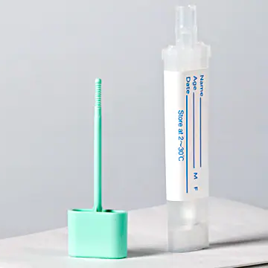
Why should NBCSP kits be used?
NBCSP kits are preferred because:
Recording of results in NCSR
Automated reminders
Kits are mailed when screening is due
Simple – only 2 samples needed
Recall of patients – abnormal results
Long-term data collection
Notes:
SPEAKER
A key takeaway from this training is that:
- Private pathology iFOBTs should not be used for screening in place of NBCSP kits for eligible, asymptomatic patients
There are many good reasons for encouraging patients to use NBCSP kits:
- The NCSR stores the results of program tests and provides automatic reminders to the patient to complete the test.
- Once a NBCSP kit is returned, results are sent to the healthcare provider and the patient.
The NBCSP kit is mailed to the patient when their next screening test is due
The NBCSP kit is easy to complete— only two samples are required, and the patient mails the samples back in a supplied reply-paid envelope.
- Encouraging the use of NBCSP kits also helps inform national bowel cancer data and screening policy changes such as updates to clinical guidelines and other program improvements.
For these reasons, it is important that patients who are eligible for screening use the National Bowel Cancer Screening Program kit, rather than a private pathology FOBT.

Slide 20
Why should NBCSP kits be used?
Specificity and sensitivity of NBCSP kits is standardised and evidence-based
The number of tubes and positivity threshold are the same for each test kit (2)
All Program tests are analysed in three labs
A positive FOBT follow up service is funded by the Program; additional follow-up provided by GPs
All iFOBT test results are automatically provided to the NCSR
  Positive test result: refer for colonoscopy, with results provided to the NCSR – ensures people on the correct screening pathway
  iFOBT results from private pathology kits are not included in
  population screening records held by the NCSR.
Notes:
SPEAKER
Refer to slide
In addition to the benefits that I have already mentioned:
- The NBCSP test kit design, handling, sourcing and analysis is standardised and heavily quality controlled
- A mentioned the number of tubes required under the NBCSP is only 2 and the positivity threshold is the same for each test kit
- All Program tests are analysed in only three dedicated labs in Australia, which ensures quality control and standardisation
- All test results are automatically provided to the NCSR which means that the results are accessible regardless of the patient's or provider's location.
- A positive test follow up service is funded by the Program as a safety net in addition to follow-up provided by GPs
- Results from a colonoscopy a procedure undertaken based on a positive NBCP iFOBT kit should be uploaded to the NCSR.
- Colonoscopy results for procedures performed for reasons unrelated to a positive NBCSP kit result, are not held by the NCSR but are used to determine someone’s next screening invitation.
It is important to note that iFOBT results from private pathology kits are not included in population screening records held by the NCSR which is another good reason

Slide 21
When can private pathology kits be used?
For screening patients aged 40 to 44 or 75 to 84, where clinically appropriate.
For screening patients aged 40-84 who do not hold a green Medicare card.
For diagnostic purposes and as a risk stratification tool for patients who are symptomatic or at moderate or high risk of colorectal cancer.
Notes:
SPEAKER
There is still a role for private pathology kits outside of the NBCSP including:
- For screening purposes - people aged 40 to 44 and people aged 75 to 85 can be offered a private kit for the purposes of bowel cancer screening as deemed clinically appropriate by a doctor.
For screening people who do not hold a green Medicare card as they are not eligible to screen with the NBCSP
- For symptomatic people, for example, those with gastrointestinal symptoms such as a change in bowel habit, a private pathology kit can be used as a risk stratification tool.

Slide 22
Tip 2: Integrate your practice software with the NCSR
Notes:
My second tip is to integrate your practice software with the NCSR, so let's explore the NCSR in more detail

Slide 23

The National Cancer Screening Register (NCSR)
Single electronic record for Australia’s bowel, cervical and lung screening programs
  Accessible regardless of patient location
Does not include breast cancer screening program (State/Territory-based)
Multiple ways to interact with the NCSR: viewing results/documents, reporting, updating mailing address
Healthcare Provider Portal: Accessed via PRODA
  Delegate access to practice staff
Clinical Software Integration – Best Practice, Medical Director, Communicare, MMEx
Notes:
SPEAKER
What is the National Cancer Screening Register?
The National Cancer Screening Register (NCSR) is a digital platform supporting the National Bowel Cancer Screening Program, the National Cervical Screening Program and the National Lung Screening Program, which has commenced as of July 1. The BreastScreen Australia Program is not delivered via the National Cancer Screening Register and is instead delivered by each State/Territory. As such, screening mammogram results are not held by the NCSR.
Screening registers play an important role in organised cancer screening programs, enabling secure access to screening information, facilitating participant and healthcare provider engagement, providing fail-safe follow-up of screening detected abnormalities and providing comprehensive data to inform policy, monitor performance and guide program improvements.
Clinicians can access the NCSR to view patients’ results for each of the three supported screening programs (bowel, cervical and lung). The NCSR, as a central repository of screening information, ensures a patient’s record can be accessed from anywhere. For example, if a patient moves to a different location or changes clinic, their screening history, past results and other screening related information can be accessed by their new provider.
Healthcare providers can access the NCSR via the Healthcare Provider Portal, which is accessed through PRODA and the NCSR website or through their integrated clinical software. The NCSR can be accessed by GPs or other specialists, pathologists or other healthcare providers who have Medicare provider numbers or their delegates. Clinics can, for example, set up practice nurses or other practice staff who do not have a Medicare provider number, to be delegates of health practitioners who do have a Medicare provider number, which can streamline workflows and allow other staff members to access results.
One of the most efficient ways of accessing the NCSR however is by integrating your clinical software with the NCSR, which is available for Best Practice, Medical Director, Communicare and MMEx. Having integration set up means that you don't need to log in through PRODA each time that you want to access the patient's NCSR record. There are some handy guides on the NCSR website which walk you through the software integration process or you can contact the NCSR via phone for troubleshooting.

Slide 24
NCSR does not capture non-program issued kits
Why?
Program compliance
Follows the Australian Population Based Screening Framework and meets WHO
criteria for cancer screening
Reasons for not holding non-NBCSP tests in the NCSR:
Used for symptomatic/non-screening purposes, not population screening
Tested at a range of labs with differing quality assurance processes
Inconsistent follow-up leading to mismatched clinical pathways
Non-standardised thresholds for ‘positive’ results making results hard to compare
Reporting difficulties due to incomplete or non-standardised data
Notes:
SPEAKER
I mentioned earlier that private pathology iFOBT kit results are not stored in the NCSR. Why is this? The NBCSP operates in accordance with the Australian Population Based Screening Framework and meets the World Health Organization’s (WHO) criteria for the assessment of the benefits, risks and costs of cancer screening.
The WHO criteria requires screening programs to:
- take a consistent approach to sample testing and diagnostic thresholds for what constitutes a positive result.
- take a consistent approach to how people are screened, who is eligible to be screened and how often screening occurs
- ensure a screening participant can be identified as a patient requiring diagnostic follow-up and treatment.
Adherence to the WHO criteria presents barriers for holding non-NBCSP kit results on the NCSR. Non-program tests:
- are often used for symptomatic or non-screening purposes related to individual care as opposed to population screening
- are not subject to the same consistent quality assurance processes that are applied to program tests (i.e. all NBCSP labs follow the same quality assurance processes)
- may result in patients on clinical pathways that are inconsistent with the bowel cancer screening program guidelines
- use a variety of thresholds for what constitutes a positive result and therefore will not always be directly comparable to positive results obtained through Program tests, resulting in non-standardised or inconsistent data
- produce results and follow-up actions that would not be recorded in a standard manner, making reporting difficult to interpret.

Slide 25
Tip 3: Bulk order kits via the alternative access model
Notes:
My third tip to increase screening participation is to be able to issue kits via the alternative access model
What does this mean? Let's go through it together.

Slide 26
Summary of the National Indigenous Bowel Screening Pilot
Menzies School of Health Research were funded by the Department of Health in 2015 to review and trial alternative ways of getting bowel cancer screening kits to Aboriginal and Torres Strait Islander people
The National Indigenous Bowel Screening Pilot (November 2018 – October 2019)
47 centres enrolled; 44 approved to distribute kits; 36 actively participated
>1000 Indigenous adults aged 50-74 were identified (865 accepted a kit and 390 completed the kit)
Notes:
SPEAKER
Before we talk in detail about the NBCSP’s alternative access to kits model, it is important to understand HOW we got here and the evidence that underpins this model.
In 2015, the Australian Government funded Menzies School of Health Research (Menzies) to look at alternative ways of getting bowel cancer screening kits to Aboriginal and Torres Strait Islander people.
A Pilot ran from November 2018 – October 2019 to improve bowel cancer screening participation among Aboriginal and Torres Strait Islander people by distributing screening kits through primary health care centres. Clinic sites around the country with high numbers of Aboriginal and Torres Strait Islander people participated in the pilot.

Slide 27
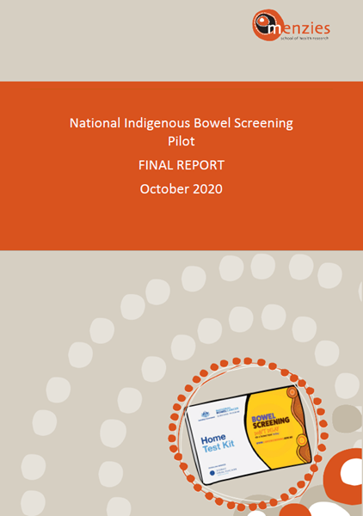
Pilot key findings
Screening participation rates with the Pilot (39.8%) versus the usual mail-out model (23.3%), similar rate to non-Indigenous Australians (40.6%)
Biggest increase in participation was seen in Indigenous men
Prompt kit return compared to the usual mail-out model: 13 days compared to 34 days
Greater reach into under screened populations, including low SES/remote areas
Healthcare provider endorsement and direct access to the iFOBT kit helped improve participation rates
Notes:
SPEAKER
Participation through the Alternative Pathway was significantly higher in Aboriginal and Torres Strait Islander people than that of the usual mailout pathway and a similar rate to that of non-Aboriginal and Torres Strait Islander Australians.
Other key findings of the pilot included:
- The median return time for kits was 13 days, compared to 34 days in the usual pathway.
- There was better participant understanding of the importance of the test and procedures.
- Greater reach into under screened sections of the population (such as those who had been invited previously but not screened; those who live in areas of low socio-economic status or remote areas) than through the usual pathway.

Slide 28
The alternative access to kits model – now widely available
Talking with a healthcare provider can be key to people deciding to do iFOBT
Involves supplying a kit directly from the clinic – must print off a Participant details form to accompany the kit
Bulk order kits – in batches of 10
Beneficial when targeting cohorts with low screening rates/priority populations
Provides opportunities for demonstrating the simplicity of the kit
Assisting people to complete the participant test kit documentation
Notes:
SPEAKER
Following the positive findings of the Pilot, the NBCSP rolled out the alternative access model nationally in late 2022. This is now a great alternative to handing out a private pathology kit and instead being able to hand out a NBCSP kit to your patients who are eligible to screen.
The face-to-face approach of the model also gives the healthcare provider an opportunity to demonstrate the simplicity of the kit and answer any questions the patient may have.
We know some people are more likely to screen if they walk away with a kit in their hand, rather than waiting for it to arrive in the post.
While the focus for engagement through this model are people from groups with low screening rates, anyone who is eligible to screen with the NBCSP can receive a kit through the alternative access model. To streamline access to kits, health provider or their delegate can bulk order kits through PRODA in batches of 10, up to a maximum of 100 at a time.
This means anyone between the ages of 45-74 can be given an NBCSP kit by a healthcare provider. It is really important that if you provide a kit to a patient, you issue it correctly in the NCSR (either through the Healthcare provider portal in PRODA or via the integration with your clinical software), print off the Participant details form which is populated as part of the process and give it your patient so that it can be sent back with the samples. The participant details form is accessed via the NCSR, either through PRODA or the NCSR integration. If you forget to issue the kit in the NCSR alongside the Participant details form, the NBCSP’s pathology provider may not be able to test the returned samples.
Engaging in the alternative access to kits model is really no different to arranging for your patient to do a private pathology iFOBT, except with the added benefits the NBCSP and NCSR provides.

Slide 29
Summary - Tips for implementing NBCSP processes
Set up NCSR clinical software integration (practice manager)
Set up delegate access (e.g. practice nurse, practice manager, admin staff) with the NCSR to:
  Bulk order kits
  Issue kits to eligible participants
Check your patient's address listed on the NCSR
Want more information or need help?
Visit www.ncsr.gov.au or
Call the contact centre on 1800 627 701
Notes:
SPEAKER
To summarise, there are a number of strategies that can be implemented within your practice to streamline your clinic’s interaction with the NCSR.
Firstly, setting up NCSR integration. Integrating your practice software with the NCSR ensures it is easy to find screening information for your patient and submit both National Bowel Cancer Screening National Cervical Screening Program forms online. Our first webinar of our 4-part webinar series covers integration with the NCSR in more detail.
Your practice or office manager is able to complete the integration process.
We have been hosting webinars about the National Cancer Screening Register and integration. If you cannot attend one of the live webinars, you can watch a recording on the NBCSP Healthcare Provider Learning Hub (refer to the link at end of today’s presentation). There are excellent resources online about troubleshooting NCSR integration issues or you can phone them on the 1800 number.
Second, utilise the NCSR’s delegate access functionality. Setting up delegate access can be an important time-saving measure for busy GPs and enables practice nurses or other practice staff such as administrative staff/managers to complete administrative tasks on your behalf – such as bulk ordering alternative access model kits or submitting NBCSP reports and forms.
Your delegates can also access the NCSR to review results or issue kits on your behalf, such as during a health assessment conducted by a practice nurse.
One other process improvement is to look at the patient's address listed on the NCSR. This is one of the most common reasons why patients are not receiving kits in the mail. The patient themselves or a healthcare provider can manually update the address on the NCSR. Note updating an address in the NCSR won’t update the patient’s Medicare address.

Slide 30
Q&A
Notes:
SPEAKER
Thank you. I will now answer any questions that you have.
[Refer to FAQ document as needed.]

Slide 31

Brainstorm:
Which subgroups of the population are less likely to participate in bowel cancer screening?
Notes:
SPEAKER
We are now going to shift gears and look at population groups who have historically participated at a lower rate than the rest of the population in the NBCSP.
We have discussed that only 40% of the eligible population participates in the NBCSP. However, there are some subgroups of the population with even lower rates of participation. Who do you think these subgroups include?

Slide 32

Under screened population groups
First Nations people
People with a disability
CALD populations
Rural and remote
Men aged 50-60
Refusers, naïve people - that is people who just don’t want to do the screening test or think that they don’t need to do it
Notes:
SPEAKER
Data from the Australian Institute of Health and Welfare shows that people from these groups are also more likely to have poorer outcomes for colorectal cancer treatment and survival as the cancers are usually more advanced when first detected or access to treatment problematic. Engaging these groups is a priority for the NBCSP.

Slide 33
Program participation, positivity and diagnostic assessment rates (persons 50–74) 2022-2023
Population group | Participation rate | Screening positivity rate | Diagnostic assessment rate
Aboriginal and/or Torres Strait Islander people | 38% | 8% | 78%
People with a disability | Not published | 11% | 70%
Language other than English at home | 24–31% | 6% | 80%
People living in remote areas | 34% | 8% | 85%
People living in very remote areas | 25% | 8% | 82%
Males aged 50–59 | 33% | 6% | 86%
Total eligible population (50–74) participation | 42% | 6% | 86%
Source: AIHW (2025) National bowel cancer screening program monitoring report 2025, catalogue number CAN 164, AIHW, Australian Government.
Notes:
SPEAKER
This table which is from the latest AIHW report into the NBCSP shows the NBCSP participation rates for different population groups, along with their screening positivity rates and diagnostic assessment rate (i.e. how many go on to have a colonoscopy) for the two year period covering 2022-2023. Bear in mind that as this data was from 2022-23, it only includes people aged 50-74 as the lower age of screening had not yet commenced.
Participation in the NBCSP for the under screened groups shown in the slide is lower than the total eligible population.
The second column indicates the screening positivity rate, that is, the likelihood that the FOBT will return a positive result for blood. In the total eligible population, this sits at 6%. For many of the under screened groups, they are more likely to return a positive iFOBT, yet most of these under screened groups are less likely to go on to have a diagnostic assessment.
If we can encourage more under screened groups to participate in the NBCSP this will mean more people will go on to receive diagnostic colonoscopies and more cancers can be detected, ideally at an early stage.
[Note: AIHW definition of Diagnostic assessment rate: The percentage of people who returned a positive NBCSP screening test (warranting further assessment) between 1 January 2023 and 31 December 2023 and had follow-up diagnostic assessment within that period or by 31 December 2024.]

Slide 34
Barriers to participation
Patient-related barriers
Provider-related barriers
System-related barriers
Notes:
SPEAKER
There are a number of barriers people can face when it comes to bowel screening. By understanding factors that influence a person’s decision to screen, especially among population groups who tend to screen less, healthcare providers can better support and encourage participation in the program.
Some of these barriers may be specific to a particular group of people, whereas other barriers may be applicable to everyone.
There are generally three kinds of barriers – patient related, provider related and system related.
Patient-related – These are factors specific to the individual themselves, such as culture, language, health literacy or practical considerations around their geographic location.
Provider-related barriers – These can include availability of healthcare providers, the length of appointments and health provider awareness of particular population groups and how they can best be engaged in screening.
System-related barriers – for example, the need to collect two samples from two different poos and the fact that poo is involved; the need to keep samples cool; and the need to take samples to the post office or find a post box.
We do have more information about under screened populations in the third webinar of our 4-part webinar series in addition to Elective Module 1.

Slide 35

Small group activity: 15 minutes
Case studies
Men aged 50-60
First Nations people
People with a disability
CALD populations
Rural and remote
Notes:
SPEAKER
[Although 5 case studies are provided for each table, speaker to please allocate each table/group to ONE case study. If there are more than 5 tables, then some of the tables will be doing the same case study. After 15 minutes of small group discussion, bring the whole group back together again and select a spokesperson for some of the groups to share more widely with the larger group what they discussed as the answers to the questions. Given you will likely have around 15 minutes for the whole-group discussion, it is unlikely that you will have time for a spokesperson for all 5 case studies and it is important not to run over time. If there is only time for 2-3 case studies to be discussed as a whole group, this is fine. This is also an opportunity to fill in any gaps from your facilitator notes about the case studies]:
[In person workshop]
We have provided you with five case studies on your table but will indicate which case study each group will discuss in the next 15 minutes within your group. (Speaker to please point at each table and call out which case study they are to focus on). This exercise is designed to get you thinking about what audit activity you might choose to undertake. Discussing these cases as a group contributes to your reviewing performance CPD hours. I will also pop around to each group to help answer any questions. Are there any questions now before we break?
[Online workshop]:
In the meeting chat there is a link to five case studies and we will allocate you into breakout groups. Over the next 15 minutes, we will indicate which case study your breakout group is to read and discuss. Discussing these cases as a group contributes to your reviewing performance CPD hours. Breakout groups of 4-8 people will be allocated automatically. There will be a timer clock at top of the screen and a 1 minute warning prompt before you are automatically brought back into the main room. We will also pop into each breakout group to help answer any questions and see how each group is going. Are there any questions now before we break?
NOTE FOR SPEAKERS: At the end of the 15 minutes,

Slide 36
Case studies – in summary​
Barriers​
Identify cognitive, emotional, physical/location, cultural, social, and/or environmental factors ​
Patient perceptions and attitudes ​
Health misconceptions, myths and/or bias ​
Reduced health literacy​​
Strategies​
Reduce barriers and patient misconceptions/perceptions ​
Build trust and rapport ​
Provide health education​
Offer a tailored approach
Notes:
SPEAKER
Well done everyone for participating in the Case Study discussion. Hopefully you had a lot of good quality discussion in your small groups. Although each under screened population group has distinct barriers to participating in bowel cancer screening there are also a lot of common themes among the groups which you may have noticed. Some of these include:
Barriers
- Barriers due to cognitive, emotional, physical/location, cultural, social, and/or environmental factors (e.g., emotional = Confidence and/or anxiety; coping factors= avoidance; cultural = language/English literacy/lack of cultural safety)
- Patient perceptions and attitudes (perceptions of cost, ’ickiness’, time, effort, time off work, pros and cons, attitude such as “don’t fix it if not broken”, motivation/avoidance)
- Health misconceptions, myths and/or bias (e.g. Case study #3 Group home staff or care team)
- Reduced Health literacy (including due to cognitive, emotional, physical, cultural, social or environmental factors)
There are also some common themes around strategies for engagement among the under screened groups.
Strategies
- Reduce barriers and misconceptions/perceptions (e.g. convenience of home screening test or getting kits from GP; use of interpreters; providing information/videos in different languages) = use of motivational interviewing techniques
- Build trust and rapport through conversations/discussions e.g. long appt to allow adequate time (Case study #3 including with a person’s family, support workers or care team)
- Provide Health Education (increasing understanding and health literacy e.g. assisting patients to perceive more ‘pros’ than ‘cons’ = reduce myths and biases)
- Offer a tailored approach (e.g. offer a patient specific approach, tailored to their needs, whether cultural, language, emotional, social or cognitive)
We have written some suggested responses to the questions presented in the case studies which you will be provided with via email after the workshop, but did anyone have any questions or comments in relation to the case studies?
(OPPORTUNITY FOR ATTENDEES TO ASK QUESTIONS)

Slide 37

BREAK
Notes:
SPEAKER
We are going to have a short break before getting back to our audit activity
[In-person workshop]: 15 minute break

Slide 38
Conducting a mini audit
for NBCSP
Notes:
SPEAKER
We have spoken about the importance of bowel cancer screening in Australia and have highlighted some of the population groups who are most under screened and you can use this knowledge and motivation as a reason for conducting a mini audit or a full audit within your practice.
The remainder of the workshop will be dedicated to activities which can set you, as a practitioner or your practice team, up for completing a mini audit or a full audit if you choose.
The first step with performing a mini audit is always the hardest, so we have pulled together a range of tools and resources to get you started.

Slide 39
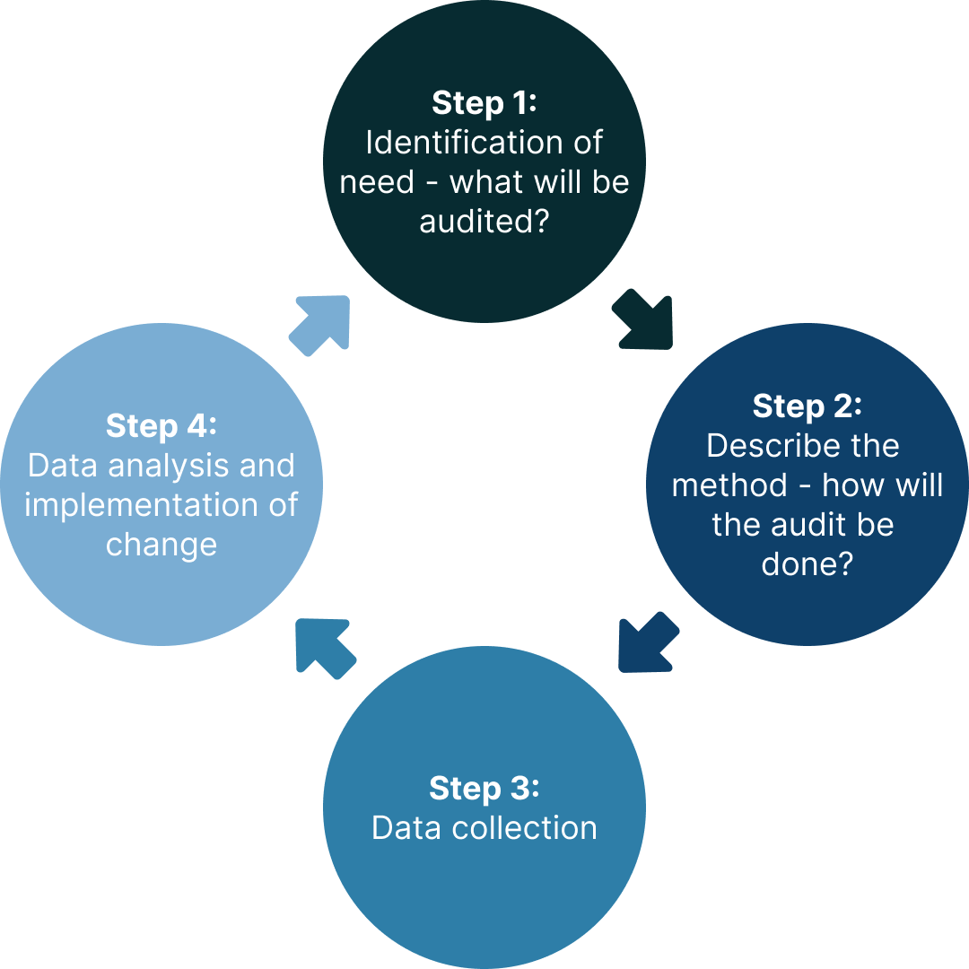
How to conduct
a mini audit
Notes:
SPEAKER
In order to commence your mini audit, you first need to pick a topic to audit, as we have previously outlined.
The second step is to describe the method of the audit. As mentioned, there are a number of tools available within your practice software and also external data extraction tools.
Step 3 is about actually collecting the data from these data extraction tools.
And the final step is where you analyse the data and determine what steps to take within your practice to improve the data for the next cycle.
Step 5, which is not shown on this infographic is about documentation and reporting.
If you determine down the track that you want to do a full audit, then the cycle can be repeated.

Slide 40
Possible audit topics
What percentage of my patients aged 45-74 have never screened with the NBCSP or are overdue for screening with the NBCSP? (Selection of a particular cohort is also possible, e.g. First Nations people, people living with disability etc.)
Of the patients who have had a positive NBCSP FOBT, what percentage have their colonoscopy results recorded in the NCSR?
Of the patients who were recently sent for a private FOBT, has their participation in the NBCSP been deferred?
Of the patients who are having regular colonoscopies, has their participation in the NBCSP been deferred or have they been opted out?
Notes:
SPEAKER
In order to assist you in your mini audit, we have come up with a number of different audit topics. The previous exercise where we looked at under screened populations, may act as a prompt for you to consider auditing only a subpopulation of your patient base. Some of these may be more relevant than others, based on your workplace and patient population. Some of these may also be more challenging to audit than others, so consider this when selecting an audit topic.
This list is not an exhaustive list of possible audit topics, and you can come up with your own which may suit your patient population even better. The first mini audit topic on the list is the one most commonly selected.
(Go through the list):
- What percentage of my patients aged 45-74 have never screened with the NBCSP or are overdue for screening with the NBCSP? (Selection of a particular cohort is also possible, e.g. First Nations people, people living with disability etc.)
- Of the patients who have had a positive NBCSP FOBT, what percentage have their colonoscopy results recorded in the NCSR?
- Of the patients who were recently sent for a private FOBT, has their participation in the NBCSP been deferred?
- Of the patients who are having regular colonoscopies, has their participation in the NBCSP been deferred or have they been opted out?
The last three audit topics shown on the screen have more manual processes required to complete the audit whereby you will need to utilise your own clinical software, data extraction tool and be able to access the NCSR in order to carry out the audit.

Slide 41
Audit group activity Part 1: 10 minutes
Steps:​
Select a mini audit topic for you to conduct in your practice​ (you don’t have to choose the same topic as others on your table)
Discuss how you would collect this data on your subject?
​
Refer to the sample mini audit template and complete Step 1 of the template
Notes:
We’re now going to break again into small groups for 10 minutes.
The fist step in any audit is deciding what your subject will be. For this example, we are looking at people who identify as Aboriginal and Torres Strait Islanders. As we have just learnt they are an under screened sub-group of our population. You may choose to select all sub-groups or may not focus on a sub-group at all.
Facilitator to hold up mini audit hand out and point top section – Step 1
We have provided you with a mini audit tool template on your table. With this in front of you, I want you to discuss ideas for your chosen audit topic within small groups. You don’t all need to select the same topic. Next, discuss what software provider and data extraction tools that you use within your practice with your peers. Use each other to bounce ideas off and begin to fill out your templates. You will note that we have provided you with blank templates in addition to a sample pre-filled template which you can also explore within your group to see how an example mini audit was conducted. I will also pop around to each group to help answer any questions. Are there any questions now before we break?
Now you identified your subject what do you aim to do, once you have identified them?
In this example we are saying that we want to improve advocacy and education for NBCSP participation with patients who identify as Aboriginal and Torres Strait Islander aged between 45-74.
(facilitator to run through Step 1 and 2 in the example template in detail)
Now its your turn – in your groups at the table

Slide 42

Tools for conducting an audit
Mini audit template
Clinical practice software, e.g. Best Practice Premier, MedicalDirector etc.
Additional data extraction tools as appropriate, e.g. Primary Sense, PenCAT, Cubiko
Access to the NCSR
Keep accurate documentation of your audit
  Minimum 6 hours for a mini audit
Notes:
SPEAKER
We provided you with a template for conducting a mini audit via email prior to today’s workshop and we have also provided additional copies on your tables (for F2F attendees).
The mini audit template can both be used towards your mini audit and your practice's quality improvement activity. We will look at this in more detail.
You also need to be familiar with your clinical practice software as they often have in-built search tools. Your practice manager may be able to assist you to find these search functions, and if unsure, the software provider can also be contacted to provide further information about how to use these functions.
Many practices also have access to external data extraction tools, often through the local Primary Health Network, or if you work for a corporate clinic, you may have access to additional data extraction tools. These can also be used for your mini audit.
Access to the NCSR is also critical for conducting your mini audit.
Ensure that you are keeping accurate records for any audit activity that you undertake as this is important for CPD requirements.
The Royal Australian College of General Practitioners (RACGP) recommends a minimum of 6 hours for a mini audit and a minimum of 10 hours for a full audit.

Slide 43
Audit group activity Part 2: 10 minutes
Steps:​
Consider what you might do to improve uptake within your practice ​
Set some SMART goals that you can implement – see below
Complete Step 2 of your mini audit template
​
Specific
S
G
Measurable
M
O
Attainable
A
A
Relevant
R
L
Time-bound
T
S
Notes:
We’re now going to break again into small groups for 10 minutes.
With the mini audit tool template you have been working with, imagine you now have a list of identified people based on your subject and aim.
What can you do within the scope of your role to encourage screening?
Turn these ideas into SMART goals.
Facilitator to provide an example:

Slide 44
Audit pitfalls
Data extraction tools vary – limitations exist
  Familiarise yourself with your software
Depends on how results from NCSR are ingested in the patient record e.g. as a PDF or within “investigations” or “results” tab
Data extraction tools often won’t pick up NBCSP iFOBTs in a PDF – data needs to be within “investigations” or “results” tab
The NCSR does not currently have a data extraction function – manual checking is required
May wish to exclude patients who have had private FOBTs for the purpose of the audit
Notes:
SPEAKER
Undertaking an audit can be challenging and very rarely involves only a few clicks of the buttons!
You all work in different practices and therefore use different software platforms and clinical data extraction tools and they will all vary in functionality. Regardless, there are some common watchpoints you need to be aware of when conducting your audit. We have collated information about most of the big clinical audit tools used in general practice, so hopefully yours is on the list. This includes some instructions for how you are able to use them to assist you in your audit, but your local PHN or the companies providing the audit tool can also give you additional information and support and can often run you through the process of using the tool.
One of the pitfalls however, is that data extraction tools may not pick up all NBCSP iFOBTs results. Capturing this information depends on how your practice software receives results from Sonic, who are the NBCSP’s pathology provider and processes the iFOBTs. If you receive your NBCSP results within your “investigations” or “results” tab in the same format as any other investigation result, then it is more likely to be picked up by the data extraction tool. If your software ingests the results as a PDF, then it is possible that the data extraction tool may not pick it up
Another is that the NCSR does not currently have a data extraction function – manual checking is required between your clinical software and the NCSR to ensure you have the required data.
- As a result, auditing all of your patients may not be possible and you may need to perform a mini audit of a set number of patients, such as 10 or 20.
The most efficient way to access the NCSR is to integrate it with your practice software, which we have mentioned earlier in the workshop and to utilise delegate access for the NCSR. This can mean that other members of your practice team, such as practice manager or a practice nurse can be involved in some of the data collection for the purpose of the mini audit.

Slide 45
Small group activity – wrap up
Notes:
SPEAKER
[Note for speakers: please ask for a volunteer to share their discussion within their group to the larger audience. eg what topic did they choose, what method of data collection do they anticipate using, what are their SMART goals to progress their mini audit?]
Well done everyone for participating in the mini audit discussion. Hopefully this has helped you to plan what mini audit activity you may wish to undertake within your practice and where you can go for further information.
I would like a volunteer to share what they discussed within their group about their mini audit topic, planned method of data collection and SMART goals to progress the audit. (If no one volunteers, then please pick one of the GPs at random)
You may wish to complete the rest of the mini audit yourself, or role it out more widely within your practice as a practice-wide Quality Improvement activity. This could be communicated via a practice meeting and considering those barriers and enablers to different under screened population groups participating in the NBCSP. It is also important to put in place the most efficient processes and integrations which I will summarise on the next slide.

Slide 46
Workshop summary
Overview of the National Bowel Cancer Screening Program
  National Cancer Screening Register – integrate with your software
  Alternative access to kits model – don't use private pathology kits
Under screened populations
  Barriers to participation
  Small group discussion: ways of overcoming barriers
Mini audits: complete the post-workshop activity
  Consider ways to improve patient engagement in the Program
Notes:
SPEAKER
We are now going to recap what we have learned during tonight's workshop.
In this workshop we have covered the National Bowel Cancer Screening Program including the National Cancer Screening Register and it's benefits including the participant follow up function and the ability to delegate access to the NCSR to other members of your practice team. This can be particularly helpful for the alternative access to kits model where delegates can bulk order kits to your practice. We have talked about the alternative access to kits model being available to you to hand out a kit directly to your patients and the reasons for avoiding private pathology kits.
We touched on the National Cancer Screening Register and ways to integrate this within your practice software to improve efficiency in issuing kits, submitting reports to the NCSR and checking on a patient's screening history and follow up colonoscopy results where relevant. For troubleshooting, the NCSR can be contacted to walk you through this process of integration or you can refer to the integration guides online.
We have also talked about under screened populations, their barriers to participation and ways to overcome them. We have also talked about mini audits and you have started to fill out your templates and plan for carrying out this mini audit within your practice to improve patient engagement with the NBCSP.
Remember that the time you take towards this mini audit post-workshop can be self-logged as CPD hours. For medical practitioners, this comes under Measuring Outcomes hours. Make sure you keep records of this audit, such as by completing the mini audit template. We have provided you with a sample pre-filled template of how you might record your post workshop hours. Practices can also count these activities towards their Quality Improvement Practice Incentive Payment for the year.

Slide 47
Q&A
Notes:
SPEAKER
Thank you. I/we will now answer any questions that you have.
[Refer to FAQ document as needed.]

Slide 48
Post-knowledge check
Notes:
GPEx FACILITATOR

Slide 49




CPD hours
Approved for 3 CPD hours with the RACGP and ACRRM:
1.5 hours Education Activities
1 hour Reviewing Performance
0.5 hour Measuring Outcomes
Endorsed by the Australian College of Nurse Practitioners (ACNP) and National Association of Aboriginal and Torres Strait Islander Health Workers and Practitioners (NAATSIHWP).
A Statement of Completion will be emailed to each attendee within the month.
RACGP and ACRRM members will be accredited with CPD hours automatically.
Notes:
GPEx FACILITATOR

Slide 50

Additional post-workshop CPD available
Additional Measuring Outcomes CPD hours are available by completing the mini audit activity you started today at the workshop. Additional CPD hours will need to be self-logged.
In the following days, we will also email you with an optional two-part behaviour change activity to help you reflect on and enhance your clinical practice. Completing this activity will entitle you to self-log an additional 1 hour of Reviewing Performance CPD hours.
Notes:
GPEx FACILITATOR

Slide 51





National Bowel Cancer Screening Program Healthcare Provider Learning Hub
Online courses | Workshops | Webinars | Resources | CPD-eligible
gpex.com.au/nbcsp-education
Notes:
GPEx FACILITATOR

Slide 52
Trusted Quality Education
For Primary Care

